Slide 1
BASIC COMP. ARCHITECTURE Bachelor of Computer Science (Hons) (Network Technology and Cybersecurity) MODULE CODE: BCA114

Slide 2
CLO 5 & 6

Slide 3
Computer Architecture’s Changing Definition
1950s to 1960s: Computer Architecture Course = Computer Arithmetic
1970s to mid 1980s: Computer Architecture Course = Instruction Set Design, especially ISA(Instruction Set Architecture) appropriate for compilers
1990s: Computer Architecture Course = Design of CPU, memory system, I/O system, Multiprocessors

Slide 4
Instruction Set Architecture (ISA)
software
instruction set
hardware

Slide 5
Instruction Set Architecture
Instruction set architecture is the structure of a computer that a machine language programmer must understand to write a correct (timing independent) program for that machine.
The instruction set architecture is also the machine description that a hardware designer must understand to design a correct implementation of the computer.

Slide 6
Instruction Set Architecture (ISA)
Serves as an interface between software and hardware.
Provides a mechanism by which the software tells the hardware what should be done.
High level language code : C, C++, Java, Fortran,
compiler
Assembly language code: architecture specific statements
assembler
Machine language code: architecture specific bit patterns
software
instruction set
hardware

Slide 7
Interface Design
A good interface:
Lasts through many implementations (portability, compatibility)
Is used in many different ways (generality)
Provides convenient functionality to higher levels
Permits an efficient implementation at lower levels
use
imp 1
time
Interface
use
imp 2
use
imp 3

Slide 8
Instruction Set Design Issues
Instruction set design issues include:
Where are operands stored?
registers, memory, stack, accumulator
How many explicit operands are there?
0, 1, 2, or 3
How is the operand location specified?
register, immediate, indirect, . . .
What type & size of operands are supported?
byte, int, float, double, string, vector. . .
What operations are supported?
add, sub, mul, move, compare . . .

Slide 9
Accumulator (computing)
In a computer's central processing unit (CPU), an accumulator is a register in which intermediate arithmetic and logic results are stored.

Slide 10
Evolution of Instruction Sets
Single Accumulator (EDSAC 1950, Maurice Wilkes)
Accumulator + Index Registers
(Manchester Mark I, IBM 700 series 1953)
Separation of Programming Model
from Implementation
High-level Language Based
Concept of a Family
(B5000 1963)
(IBM 360 1964)
General Purpose Register Machines
Complex Instruction Sets
Load/Store Architecture
(Vax, Intel 432 1977-80)
(CDC 6600, Cray 1 1963-76)
CISC
RISC
Intel x86, Pentium
(MIPS,Sparc,HP-PA,IBM RS6000,PowerPC . . .1987)

Slide 11
Classifying ISAs
Accumulator (before 1960, e.g. 68HC11):
1-address add A acc ← acc + mem[A]
Stack (1960s to 1970s):
0-address add tos ← tos + next
Memory-Memory (1970s to 1980s):
2-address add A, B mem[A] ← mem[A] + mem[B]
3-address add A, B, C mem[A] ← mem[B] + mem[C]
Register-Memory (1970s to present, e.g. 80x86):
2-address add R1, A R1 ← R1 + mem[A]
load R1, A R1 ← mem[A]
Register-Register (Load/Store) (1960s to present, e.g. MIPS):
3-address add R1, R2, R3 R1 ← R2 + R3
load R1, R2 R1 ← mem[R2]
store R1, R2 mem[R1] ← R2

Slide 12
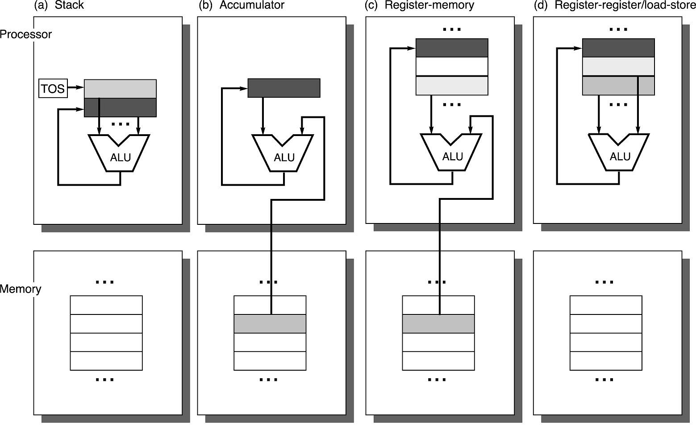
Operand Locations in Four ISA Classes

Slide 13
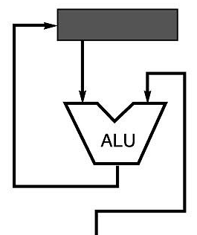
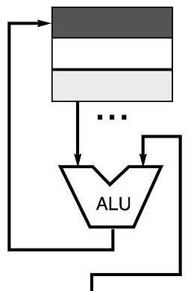
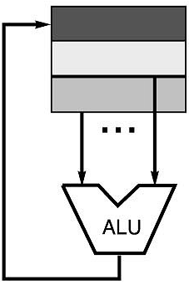
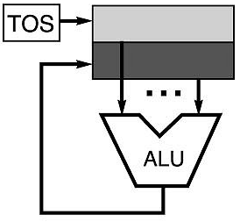
Code Sequence C = A + B for Four Instruction Sets
Stack | Accumulator | Register (register-memory) | Register (load-store)
Push A Push B Add Pop C | Load A Add B Store C | Load R1, A Add R1, B Store C, R1 | Load R1,A Load R2, B Add R3, R1, R2 Store C, R3
memory
memory
acc = acc + mem[C]
R1 = R1 + mem[C]
R3 = R1 + R2

Slide 14
More About General Purpose Registers
Why do almost all new architectures use GPRs?
Registers are much faster than memory (even cache)
Register values are available immediately
When memory isn’t ready, processor must wait (“stall”)
Registers are convenient for variable storage
Compiler assigns some variables just to registers
More compact code since small fields specify registers (compared to memory addresses)
Processor
Memory
Disk
Registers
Cache

Slide 15
Stack Architectures
Instruction set:
add, sub, mult, div, . . .
push A, pop A
Example: A*B - (A+C*B)
push A
push B
mul
push A
push C
push B
mul
add
A
B
A*B
A
C
B
B*C
A+B*C
result
A
A*B
A
C
A
A*B
A*B
A
A*B
A*B

Slide 16
Stacks: Pros and Cons
Pros
Good code density (implicit top of stack)
Low hardware requirements
Easy to write a simple compiler for stack architectures
Cons
Stack becomes the bottleneck
Little ability for parallelism or pipelining
Data is not always at the top of stack when need, so additional instructions like TOP and SWAP are needed
Difficult to write an optimizing compiler for stack architectures

Slide 17
Accumulator Architectures
Instruction set:
add A, sub A, mult A, div A, . . .
load A, store A
Example: A*B - (A+C*B)
load B
mul C
add A
store D
load A
mul B
sub D
acc = acc +,-,*,/ mem[A]
B
B*C
A+B*C
A+B*C
A
A*B
result

Slide 18
Accumulators: Pros and Cons
Pros
Very low hardware requirements
Easy to design and understand
Cons
Accumulator becomes the bottleneck
Little ability for parallelism or pipelining
High memory traffic

Slide 19
Memory-Memory Architectures
Instruction set:
(3 operands) add A, B, C sub A, B, C mul A, B, C
(2 operands) add A, B sub A, B mul A, B
Example: A*B - (A+C*B)
3 operands 2 operands
mul D, A, B mov D, A
mul E, C, B mul D, B
add E, A, E mov E, C
sub E, D, E mul E, B
add E, A
sub E, D

Slide 20
Memory-Memory : Pros and Cons
Pros
Requires fewer instructions (especially if 3 operands)
Easy to write compilers for (especially if 3 operands)
Cons
Very high memory traffic (especially if 3 operands)
Variable number of clocks per instruction
With two operands, more data movements are required

Slide 21
Register-Memory Architectures
Instruction set:
add R1, A sub R1, A mul R1, B
load R1, A store R1, A
Example: A*B - (A+C*B)
load R1, A
mul R1, B /* A*B */
store R1, D
load R2, C
mul R2, B /* C*B */
add R2, A /* A + CB */
sub R2, D /* AB - (A + C*B) */
R1 = R1 +,-,*,/ mem[B]

Slide 22
Memory-Register : Pros and Cons
Pros
Some data can be accessed without loading first
Instruction format easy to encode
Good code density
Cons
Operands are not equivalent (poor orthogonal)
Variable number of clocks per instruction
May limit number of registers

Slide 23
Load-Store Architectures
Instruction set:
add R1, R2, R3 sub R1, R2, R3 mul R1, R2, R3
load R1, &A store R1, &A move R1, R2
Example: A*B - (A+C*B)
load R1, &A
load R2, &B
load R3, &C
mul R7, R3, R2 /* C*B */
add R8, R7, R1 /* A + C*B */
mul R9, R1, R2 /* A*B */
sub R10, R9, R8 /* A*B - (A+C*B) */
R3 = R1 +,-,*,/ R2

Slide 24
Load-Store : Pros and Cons
Pros
Simple, fixed length instruction encodings
Instructions take similar number of cycles
Relatively easy to pipeline and make superscalar
Cons
Higher instruction count
Not all instructions need three operands
Dependent on good compiler

Slide 25
Registers: Advantages and Disadvantages
Advantages
Faster than cache or main memory (no addressing mode or tags)
Deterministic (no misses)
Can replicate (multiple read ports)
Short identifier (typically 3 to 8 bits)
Reduce memory traffic
Disadvantages
Need to save and restore on procedure calls and context switch
Can’t take the address of a register (for pointers)
Fixed size (can’t store strings or structures efficiently)
Compiler must manage
Limited number

Slide 26
Word-Oriented Memory Organization
32-bit
Words
64-bit
Words
Bytes
Addr.
0000
Addr
=
??
0001
Memory is byte addressed and provides access for bytes (8 bits), half words (16 bits), words (32 bits), and double words(64 bits).
Addresses Specify Byte Locations
Address of first byte in word
Addresses of successive words differ by 4 (32-bit) or 8 (64-bit)
0000
0002
Addr
=
??
0003
0000
0004
Addr
=
??
0005
0004
0006
0007
0008
Addr
=
??
0009
0008
0010
Addr
=
??
0011
0008
0012
Addr
=
??
0013
0012
0014
0015

Slide 27
Byte Ordering
How should bytes within multi-byte word be ordered in memory?
Conventions
Sun’s, Mac’s are “Big Endian” machines
Least significant byte has highest address
Alphas, PC’s are “Little Endian” machines
Least significant byte has lowest address

Slide 28
Byte Ordering Example
Big Endian
Least significant byte has highest address
Little Endian
Least significant byte has lowest address
Example
Variable x has 4-byte representation 0x01234567
Address given by &x is 0x100
Big Endian
0x100
0x101
0x102
0x103
01
01
23
23
45
45
67
67
Little Endian
0x100
0x101
0x102
0x103
67
67
45
45
23
23
01
01

Slide 29
Types of Operations
Arithmetic and Logic: AND, ADD
Data Transfer: MOVE, LOAD, STORE
Control BRANCH, JUMP, CALL
System OS CALL, VM
Floating Point ADDF, MULF, DIVF
Decimal ADDD, CONVERT
String MOVE, COMPARE
Graphics (DE)COMPRESS

Slide 30
80x86 Processor Instruction Frequency

Slide 31

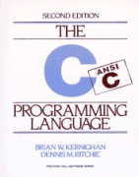
The Big Picture
SPEC
Requirements
Algorithms
f2() {
f3(s2, &j, &i); *s2->p = 10;
i = *s2->q + i;
}
Prog. Lang./OS
ISA
uArch
Circuit
Device

Slide 32
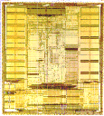
Instruction Set Architecture
Application
Instruction Set Architecture
…SPARC MIPS ARM x86 HP-PA IA-64…
Intel Pentium X
AMD K6, Athlon, Opteron
Transmeta Crusoe TM5x00
Implementation

Slide 33
Instruction Set Architecture
Strong influence on cost/performance
New ISAs are rare, but versions are not
16-bit, 32-bit and 64-bit X86 versions
Longevity is a strong function of marketing prowess (expertise)

Slide 34
Traditional Issues
Strongly constrained by the number of bits available to instruction encoding
Opcodes/operands
Registers/memory
Addressing modes
Orthogonality
0, 1, 2, 3 address machines
Instruction formats
Decoding uniformity

Slide 35
What Is Pipelining
Laundry Example
Ann, Brian, Cathy, Dave each have one load of clothes to wash, dry, and fold
Washer takes 30 minutes
Dryer takes 40 minutes
“Folder” takes 20 minutes
A
B
C
D

Slide 36
6 PM
7
8
9
10
11
Midnight
Time
30
40
20
30
40
20
30
40
20
30
40
20
T
a
s
k
O
r
d
e
r
A
B
C
D
Sequential laundry takes 6 hours for 4 loads
If they learned pipelining, how long would laundry take?

Slide 37
What Is Pipelining Start work ASAP
6 PM
7
8
9
10
11
Midnight
Time
30
40
40
40
40
20
T
a
s
k
O
r
d
e
r
A
Pipelined laundry takes 3.5 hours for 4 loads
B
C
D

Slide 38
What Is Pipelining
6 PM
7
8
9
Pipelining doesn’t help latency of single task, it helps throughput of entire workload
Pipeline rate limited by slowest pipeline stage
Multiple tasks operating simultaneously
Potential speedup = Number pipe stages
Unbalanced lengths of pipe stages reduces speedup
Time to “fill” pipeline and time to “drain” it reduces speedup
Time
T
a
s
k
O
r
d
e
r
30
40
40
40
40
20
A
B
C
D

Slide 39
Cycle 1
Cycle 2
Cycle 3
Cycle 4
Cycle 5
Cycle 6
Cycle 7
I
n
s
t
r.
O
r
d
e
r
Ifetch
Reg
ALU
DMem
Reg
Ifetch
Reg
ALU
DMem
Reg
Ifetch
Reg
ALU
DMem
Reg
Ifetch
Reg
ALU
DMem
Reg
Figure 3.3

Slide 40
Definition
conditions that lead to incorrect behavior if not fixed
Structural hazard
two different instructions use same h/w in same cycle
Data hazard
two different instructions use same storage
must appear as if the instructions execute in correct order
Control hazard
one instruction affects which instruction is next
Resolution
Pipeline interlock logic detects hazards and fixes them
simple solution: stall ­
increases CPI, decreases performance
better solution: partial stall ­
some instruction stall, others proceed better to stall early than late

Slide 41
Limits to pipelining: Hazards prevent next instruction from executing during its designated clock cycle
Structural hazards: HW cannot support this combination of instructions (single person to fold and put clothes away)
Data hazards: Instruction depends on result of prior instruction still in the pipeline (missing sock)
Control hazards: Pipelining of branches & other instructions that change the PC
Common solution is to stall the pipeline until the hazard is resolved, inserting one or more “bubbles” in the pipeline

Slide 42
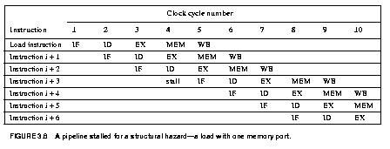
This is another way to represent the stall we saw on the last few pages.

Slide 43
Dealing with Structural Hazards
Stall
low cost, simple
Increases CPI
use for rare case since stalling has performance effect
Pipeline hardware resource
useful for multi-cycle resources
good performance
sometimes complex e.g., RAM
Replicate resource
good performance
increases cost (+ maybe interconnect delay)
useful for cheap or divisible resources

Slide 44
Structural Hazards
Structural hazards are reduced with these rules:
Each instruction uses a resource at most once
Always use the resource in the same pipeline stage
Use the resource for one cycle only
Many RISC ISA’a designed with this in mind
Sometimes very complex to do this. For example, memory of necessity is used in the IF and MEM stages.
Some common Structural Hazards:
Memory - we’ve already mentioned this one.
Floating point - Since many floating point instructions require many cycles, it’s easy for them to interfere with each other.
Starting up more of one type of instruction than there are resources. For instance, the PA-8600 can support two ALU + two load/store instructions per cycle - that’s how much hardware it has available.

Slide 45
What Makes Pipelining Hard?
Simultaneous exceptions in more than one pipeline stage, e.g.,
Load with data page fault in MEM stage
Add with instruction page fault in IF stage
Add fault will happen BEFORE load fault
Solution #1
Interrupt status vector per instruction
Defer check until last stage, kill state update if exception
Solution #2
Interrupt ASAP
Restart everything that is incomplete

